Slide 1
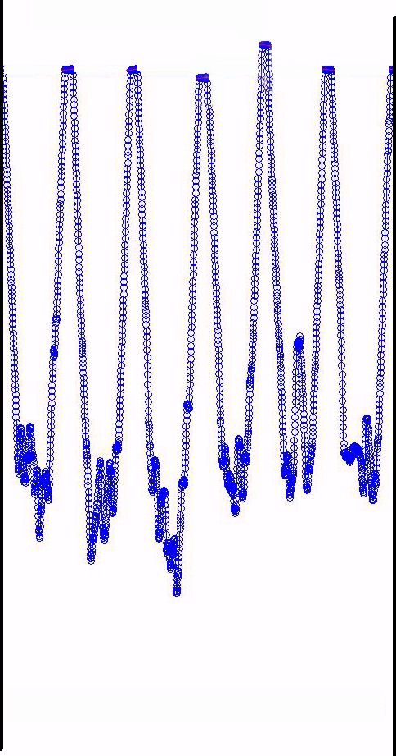
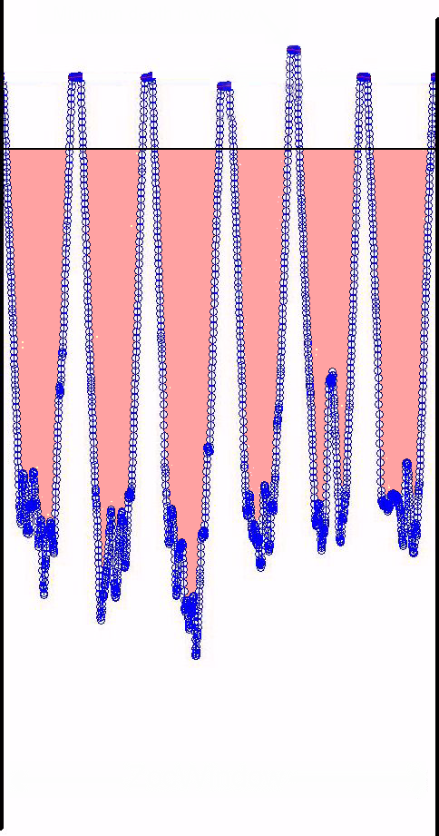
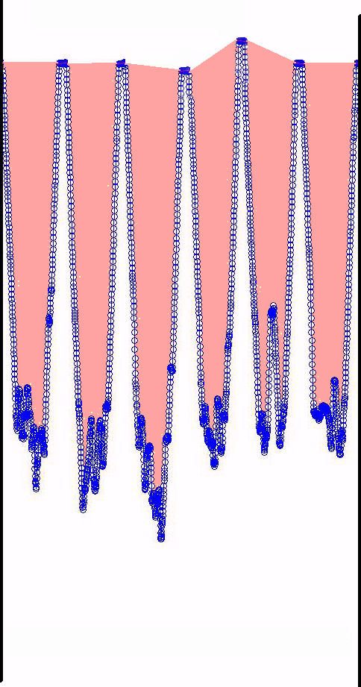
Minimum depth
in window
Mode
ZocDiveSurf
ZocWidthForMode
ZocSurfWidth
DIVES
(not surface)
ZocMinMax
ZocWindow

